Slide 1

Evaluation of performance and emission characteristics of cashew nut shell liquid with aluminum oxide (Al₂O₃)
PROJECT WORK
B.Tech - Mechanical
Richard T RA1911002020010
Deva Vishal RA1911002020035
D Venkata Satvik RA1911002020048
Darji Dattu RA1911002020096
Under the guidance of
Mr.Renuraman
[Asst Professor]
Department of Mechanical Engineering
Faculty of Engineering and technology,
SRM INSTITUTE OF SCIENCE AND TECHNOLOGY
Ramapuram, chennai-600089
*
1
Notes:
Online Speed Control of Electric Drives Using Intelligent Controllers Based on LabVIEW
1
SRMIST RAMAPURAM CAMPUS

Slide 2

INTRODUCTION :
Biofuel is an alternative to diesel fuel. Biofuels are fuels made from biomass in a short period of time, in contrast to natural processes that occur very slowly in the production of fossil fuels such as oil. Some people interchange the terms biomass and biofuel because biomass can be used directly as fuel (for example, tree trunks). The term "biofuel" is generally applied to liquid or gaseous fuels. Biofuels can be made from plant or agricultural, residential, or industrial bio-waste. The efficiency of biofuels in reducing greenhouse gas emissions varies greatly, in some cases from similar levels to fossil fuels to negative emissions in others. Bioethanol and biodiesel are the two most common biofuels.
*
Slide 1
Notes:
2
SRMIST RAMAPURAM CAMPUS

Slide 3
ABSTRACT :
In day-to-day life, fossil fuels play an important role in transportation and power generation. The consumption of fossil fuels is getting increases rapidly with increases of emission from the engines. Due to habituation over fossil fuel both the economy and environment is getting suffered. The researchers are in the position to find the best alternate for fossil fuels. The employment of biodiesel is taken to be the classy replacement for this snag. According to scores of research, using additions of nano particle is the greatest ways to control emissions and to improve engine performance. Here the assessment was employed though CNSL. Here the assessment is going to carried out in single cylinder.
*
Slide 2
Notes:
3
SRMIST RAMAPURAM CAMPUS

Slide 4
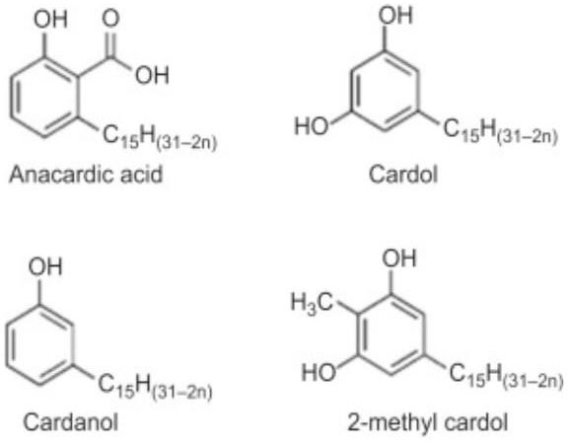
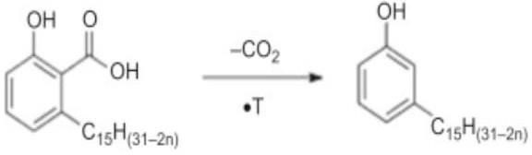
OBJECTIVE OF THE PROJECT:
Replacing the diesel with cashew nut shell liquid with aluminium oxide (Al₂O₃).
To run an CI Engine with the input mentioned above.
*
Slide 3
Notes:
4
SRMIST RAMAPURAM CAMPUS

Slide 5
WORK SCHEDULE:
WEEK | WORK
I | Title Selection
II | Literature Review
III | Extraction of CNSL
IV | Thermal Cracking
V | Selection of Nano Additives (Al2O3)
VI | Synthesis Process of Al2O3
VII | Checking Fuel Properties. (Diesel, Al2O3, CNSL, CSNL)
*
Slide 4
Notes:
5
SRMIST RAMAPURAM CAMPUS

Slide 6
WORK SCHEDULE:
WEEK | WORK
VIII | Nano additive properties SEM, TEM
IX | Engine Testing
X | Calculation
XI | Report Making
XII | Report Making
XIII | Report Making
*
Slide 5
Notes:
6
SRMIST RAMAPURAM CAMPUS

Slide 7
LITERATURE SURVEY:
Title | Cashew nut shell: a potential bio-resource for the production of green environmentally friendly chemicals, materials and fuels
Author | James Mgaya Ginena Bildard Shombe Sixberth Mlowe Egid B. Mubolu University of Dares Salaam, Tanzania.
Journal | The Royal Society of Chemistry 2019 https://www.researchgate.net/publication/330283687_Cashew_nut_shell_a_potential_bio-resource_for_the_production_of_green_environmentally_friendly_chemicals_materials_and_fuels | Accepted: January 2019
Material | Cashew Nut Shell Liquid (CNSL)
Inference | CNSL. has innumerable applications in polymer based industries such as friction linings, paints and varnishes, laminating resins, rubber compounding resins, cashew cements, polyurethane based polymers, surfactants, epoxy resins, foundry chemicals and intermediates for chemical industry. Several methods can extract CNSL: hot oil process, solvent extraction, mechanical extraction, vacuum distillation, or supercritical fluids processes: mainly hot-oil and the local roasting in which the CNSL flows out from the shell.
*
Slide 6
Notes:
7
SRMIST RAMAPURAM CAMPUS

Slide 8
LITERATURE SURVEY:
Title | Experimental investigations on combustion, performance and emission characteristics of thermal cracked cashew nut shell liquid (TC-CNSL)–diesel blends in a diesel engine
Author | A. Velmurugan M. Loganathan E. James Gunasekaran
Journal | https://www.sciencedirect.com/science/article/pii/S2772782322000833 | Accepted: March 2014
Material | Cashew Nut Shell Liquid (CNSL)
Inference | Cashew nut shell liquid (cardanol) has been explored as a potential alternate fuel for diesel engine. Thermal cracked cashew nut shell liquid has lower viscosity and lower cetane number compared to diesel. The HC, CO emissions are decreased and NOx emissions increased for higher blends of TC-CNSL compared with diesel. In general combustion characteristics of TC-CNSL improved compared with diesel. Based on the results obtained the TC-CNSL can be utilised as an alternative fuel for diesel engine.
*
Slide 7
Notes:
8
SRMIST RAMAPURAM CAMPUS

Slide 9
LITERATURE SURVEY:
Title | Utilizing cashew nut shell liquid for the sustainable production of biodiesel: A comprehensive review
Author | Michael L. Adekanbi Temilola T. Olugasa
Journal | https://www.sciencedirect.com/science/article/pii/S2772782322000833 | Accepted: 2022
Material | Cashew Nut Shell Liquid (CNSL)
Inference | Potential of cashew nut shell liquid (CNSL) for producing viable biodiesel was explored. The engine performance of CNSL biodiesel under different conditions was discussed. The compatibility of CNSL biodiesel with new engine technologies should be checked.
*
Slide 8
Notes:
9
SRMIST RAMAPURAM CAMPUS

Slide 10
LITERATURE SURVEY:
Title | Synthesis and utilization of catalytically cracked cashew nut shell liquid in a diesel engine
Author | S. Vedharaj a R. Vallinayagam a W.M. Yang S.K. Chou K.J.E. Chua P.S. Lee
Journal | https://www.sciencedirect.com/science/article/pii/S089417771500271X | Accepted: Sept 2015
Material | Cashew Nut Shell Liquid (CNSL)
Inference | CNSL has been processed effectively by catalytic cracking process for the first time 2-Methyl phenol has been figured out to be the major constituent of CC-CNSL Viscosity and calorific value of CC-CNSL were simultaneously improved BTE and peak heat release rate were found to be higher for CC-CNSL20 at 300 bar Composite HC, CO, NOX and smoke emission were within ISO emission standard.
*
Slide 9
Notes:
10
SRMIST RAMAPURAM CAMPUS

Slide 11
LITERATURE SURVEY:
Title | Utilizing cashew nut shell liquid for the sustainable production of biodiesel: A comprehensive review
Author | Michael L. Adekanbi Temilola T. Olugasa
Journal | https://www.sciencedirect.com/science/article/pii/S2772782322000833 | Accepted: 2022
Material | Cashew Nut Shell Liquid (CNSL)
Inference | Potential of cashew nut shell liquid (CNSL) for producing viable biodiesel was explored. The engine performance of CNSL biodiesel under different conditions was discussed. The compatibility of CNSL biodiesel with new engine technologies should be checked.
*
Slide 10
Notes:
11
SRMIST RAMAPURAM CAMPUS

Slide 12
LITERATURE SURVEY:
Title | Synthesis and utilization of catalytically cracked cashew nut shell liquid in a diesel engine
Author | S. Vedharaj a R. Vallinayagam a W.M. Yang S.K. Chou K.J.E. Chua P.S. Lee
Journal | https://www.sciencedirect.com/science/article/pii/S089417771500271X | Accepted: Sept 2015
Material | Cashew Nut Shell Liquid (CNSL)
Inference | CNSL has been processed effectively by catalytic cracking process for the first time 2-Methyl phenol has been figured out to be the major constituent of CC-CNSL Viscosity and calorific value of CC-CNSL were simultaneously improved BTE and peak heat release rate were found to be higher for CC-CNSL20 at 300 bar Composite HC, CO, NOX and smoke emission were within ISO emission standard.
*
Slide 11
Notes:
12
SRMIST RAMAPURAM CAMPUS

Slide 13
LITERATURE SURVEY:
Title | Experimental and finite element analysis of a coated diesel engine fueled by cashew nut shell liquid biodiese
Author | S. Vedharaj a R. Vallinayagam a W.M. Yang S.K. Chou K.J.E. Chua P.S. Lee
Journal | https://www.sciencedirect.com/science/article/pii/S0894177713002987 | Accepted: Dec 2013
Material | Cashew Nut Shell Liquid (CNSL)
Inference | CNSLME, a biodiesel produced from CNSL, has been tested in diesel engine with insulated engine components. The BTE of the engine was improved by coating the engine components by PSZ. Emission such as HC, CO and smoke were reduced, while NOX emission was increased. Coupled (thermal–stress) analysis of coated piston is presented using FEA. The average temperature, heat flux and thermal stress were lower for PSZ coated piston than uncoated piston.
*
Slide 12
Notes:
13
SRMIST RAMAPURAM CAMPUS

Slide 14
LITERATURE SURVEY:
Title | Aluminum oxide is used for its hardness and strength. Its naturally occurring form, corundum, is a 9 on the Mohs scale of mineral hardness (just below diamond). It is widely used as an abrasive, including as a much less expensive substitute for industrial diamond. Many types of sandpaper use aluminum oxide crystals.
Author | 1. S P Venkatesan Satyabhama Institute of Science and Technology 2. P N Kadiresh B. S. Abdur Rahman Crescent Institute of Engineering & Technology
Journal | International Journal of Ambient Energy https://doi.org/10.1080/01430750.2019.1614992 | Accepted: May 2019
Material | Aluminium Oxide(Al₂O₃)
Inference | Aluminum oxide is formed when aluminum reacts with oxygen. Two aluminum cations Al+3 A l + 3 form ionic bonds with three oxygen anions O−2 to form the neutrally charged aluminum oxide Al₂O₃ Aluminum oxide is used for its hardness and strength. Its naturally occurring form, corundum, is a 9 on the Mohs scale of mineral hardness (just below diamond). It is widely used as an abrasive, including as a much less expensive substitute for industrial diamond. Many types of sandpaper use aluminum oxide crystals.
*
Slide 13
Notes:
14
SRMIST RAMAPURAM CAMPUS

Slide 15
LITERATURE SURVEY:
Title | Effect of Aluminum Oxide Nanoparticles Fuel Additives on the Performance and Emissions of Diesel Engine
Author | 1. Hayder Abed Dhahad 2. Sinan Abdul Ghafar University of Technology, Iraq
Journal | Engineering and Technology https://www.researchgate.net/publication/335369151 | Accepted: May 2017
Material | Aluminium Oxide(Al₂O₃)
Inference | Aluminum oxide is formed when aluminum reacts with oxygen. Two aluminum cations Al+3 A l + 3 form ionic bonds with three oxygen anions O−2 to form the neutrally charged aluminum oxide Al₂O₃ Aluminum oxide is used for its hardness and strength. Its naturally occurring form, corundum, is a 9 on the Mohs scale of mineral hardness (just below diamond). It is widely used as an abrasive, including as a much less expensive substitute for industrial diamond. Many types of sandpaper use aluminum oxide crystals.
*
Slide 14
Notes:
15
SRMIST RAMAPURAM CAMPUS

Slide 16
LITERATURE SURVEY:
Title | Applications of aluminum oxide and nano aluminum oxide as adsorbents: review
Author | 1. Ruba Famhmi Abbas 2. Emad Mahmoud Eltayef AI-Mustansiriya University
Journal | https://www.researchgate.net/publication/335369151 | Accepted: May 2017
Material | Aluminium Oxide(Al₂O₃)
Inference | Aluminum oxide is formed when aluminum reacts with oxygen. Two aluminum cations Al+3 A l + 3 form ionic bonds with three oxygen anions O−2 to form the neutrally charged aluminum oxide Al₂O₃ Aluminum oxide is used for its hardness and strength. Its naturally occurring form, corundum, is a 9 on the Mohs scale of mineral hardness (just below diamond). It is widely used as an abrasive, including as a much less expensive substitute for industrial diamond. Many types of sandpaper use aluminum oxide crystals.
*
Slide 15
Notes:
16
SRMIST RAMAPURAM CAMPUS

Slide 17
LITERATURE SURVEY:
Title | Performance and emission analysis of di diesel engine fuelled by biodiesel with al2o3 nano additives
Author | R. Rajasekar P. Naveenchandran
Journal | https://www.sciencedirect.com/science/article/pii/S2214785321034398 | Accepted: April 2021
Material | Aluminium Oxide(Al₂O₃)
Inference | Aluminum oxide is formed when aluminum reacts with oxygen. Two aluminum cations Al+3 A l + 3 form ionic bonds with three oxygen anions O−2 to form the neutrally charged aluminum oxide Al₂O₃ Aluminum oxide is used for its hardness and strength. Its naturally occurring form, corundum, is a 9 on the Mohs scale of mineral hardness (just below diamond). It is widely used as an abrasive, including as a much less expensive substitute for industrial diamond. Many types of sandpaper use aluminum oxide crystals.
*
Slide 16
Notes:
17
SRMIST RAMAPURAM CAMPUS

Slide 18
LITERATURE SURVEY:
Title | Review of bio-fuel and nano-particles as an additive in diesel fuelled engine
Author | Govind Sharma Subodh Kumar Sharma K.V. Ojha
Journal | https://www.sciencedirect.com/science/article/pii/S221478532202449X | Accepted: April 2022
Material | Aluminium Oxide(Al₂O₃)
Inference | Aluminum oxide is formed when aluminum reacts with oxygen. Two aluminum cations Al+3 A l + 3 form ionic bonds with three oxygen anions O−2 to form the neutrally charged aluminum oxide Al₂O₃ Aluminum oxide is used for its hardness and strength. Its naturally occurring form, corundum, is a 9 on the Mohs scale of mineral hardness (just below diamond). It is widely used as an abrasive, including as a much less expensive substitute for industrial diamond. Many types of sandpaper use aluminum oxide crystals.
*
Slide 17
Notes:
18
SRMIST RAMAPURAM CAMPUS

Slide 19
LITERATURE SURVEY:
Title | A review on nanoparticles blended with diesel to improve combustion characteristics and reduction in emission of diesel engine
Author | Benjamin Franklin Selvanayagam Adarsh A. Gowtham K. Kavin S. Jagan J.
Journal | https://www.sciencedirect.com/science/article/pii/S2214785322030048 | Accepted: April 2022
Material | Aluminium Oxide(Al₂O₃)
Inference | Aluminum oxide is formed when aluminum reacts with oxygen. Two aluminum cations Al+3 A l + 3 form ionic bonds with three oxygen anions O−2 to form the neutrally charged aluminum oxide Al₂O₃ Aluminum oxide is used for its hardness and strength. Its naturally occurring form, corundum, is a 9 on the Mohs scale of mineral hardness (just below diamond). It is widely used as an abrasive, including as a much less expensive substitute for industrial diamond. Many types of sandpaper use aluminum oxide crystals.
*
Slide 18
Notes:
19
SRMIST RAMAPURAM CAMPUS

Slide 20
LITERATURE SURVEY:
Title | In ternary blend fuelled diesel engines, nanoparticles are used as an additive in biofuel production and as a fuel additive: A review
Author | M. Nagappan J.M. Babu
Journal | https://www.sciencedirect.com/science/article/pii/S2214785323001748 | Accepted: Jan 2023
Material | Aluminium Oxide(Al₂O₃)
Inference | Aluminum oxide is formed when aluminum reacts with oxygen. Two aluminum cations Al+3 A l + 3 form ionic bonds with three oxygen anions O−2 to form the neutrally charged aluminum oxide Al₂O₃ Aluminum oxide is used for its hardness and strength. Its naturally occurring form, corundum, is a 9 on the Mohs scale of mineral hardness (just below diamond). It is widely used as an abrasive, including as a much less expensive substitute for industrial diamond. Many types of sandpaper use aluminum oxide crystals.
*
Slide 19
Notes:
20
SRMIST RAMAPURAM CAMPUS

Slide 21
LITERATURE SURVEY:
Title | A comprehensive review on the usage of the nano-sized particles along with diesel/biofuel blends and their impacts on engine behaviors
Author | M.S. Gad a, Ümit Ağbulut b Asif Afzal c I Hitesh Panchal d S. Jayaraj e Naef A.A Qasem f A.S. El-Shafay g h
Journal | https://www.sciencedirect.com/science/article/pii/S0016236122041886 | Accepted: 2022
Material | Aluminium Oxide(Al₂O₃)
Inference | Aluminum oxide is formed when aluminum reacts with oxygen. Two aluminum cations Al+3 A l + 3 form ionic bonds with three oxygen anions O−2 to form the neutrally charged aluminum oxide Al₂O₃ Aluminum oxide is used for its hardness and strength. Its naturally occurring form, corundum, is a 9 on the Mohs scale of mineral hardness (just below diamond). It is widely used as an abrasive, including as a much less expensive substitute for industrial diamond. Many types of sandpaper use aluminum oxide crystals.
*
Slide 20
Notes:
21
SRMIST RAMAPURAM CAMPUS

Slide 22
LITERATURE SURVEY:
Title | Prognostic of diesel engine emissions and performance based on an intelligent technique for nanoparticle additives
Author | Hayder Abed Dhahad Ahmed Mudheher Hasan Miqdam Tariq Chaichan Hussein A. Kazem
Journal | https://www.sciencedirect.com/science/article/pii/S0360544221021034 | Accepted: August 2021
Material | Aluminium Oxide(Al₂O₃)
Inference | Aluminum oxide is formed when aluminum reacts with oxygen. Two aluminum cations Al+3 A l + 3 form ionic bonds with three oxygen anions O−2 to form the neutrally charged aluminum oxide Al₂O₃ Aluminum oxide is used for its hardness and strength. Its naturally occurring form, corundum, is a 9 on the Mohs scale of mineral hardness (just below diamond). It is widely used as an abrasive, including as a much less expensive substitute for industrial diamond. Many types of sandpaper use aluminum oxide crystals.
*
Slide 21
Notes:
22
SRMIST RAMAPURAM CAMPUS

Slide 23
LITERATURE SURVEY:
Title | Several methods can extract CNSL: hot oil process, solvent extraction, mechanical extraction, vacuum distillation, or supercritical fluids processes: mainly hot-oil and the local roasting in which the CNSL flows out from the shell.
Author | Manjunath Channappagoudra Department of Mechanical Engineering, Acharya Institute of Technology, Bengaluru-560107, Karnataka, INDIA.
Journal | International Journal of Ambient Energy https://doi.org/10.1080/01430750.2019.1614992 | Accepted: May 2019
Material | Aluminium Oxide(Al2O3)
Inference | Aluminum oxide is formed when aluminum reacts with oxygen. Two aluminum cations Al+3 A l + 3 form ionic bonds with three oxygen anions O−2 to form the neutrally charged aluminum oxide Al2O3 A l 2 O 3 Aluminum oxide is used for its hardness and strength. Its naturally occurring form, corundum, is a 9 on the Mohs scale of mineral hardness (just below diamond). It is widely used as an abrasive, including as a much less expensive substitute for industrial diamond. Many types of sandpaper use aluminum oxide crystals.
*
Slide 22
Notes:
23
SRMIST RAMAPURAM CAMPUS

Slide 24
LITERATURE SURVEY:
Title | Aluminum oxide is used for its hardness and strength. Its naturally occurring form, corundum, is a 9 on the Mohs scale of mineral hardness (just below diamond). It is widely used as an abrasive, including as a much less expensive substitute for industrial diamond. Many types of sandpaper use aluminum oxide crystals.
Author | S P Venkatesan Satyabhama Institute of Science and Technology 2. P N Kadiresh B. S. Abdur Rahman Crescent Institute of Engineering & Technology
Journal | International Journal of Ambient Energy https://doi.org/10.1080/01430750.2019.1614992 | Accepted: May 2019
Material | Aluminium Oxide(Al2O3)
Inference | Aluminum oxide is formed when aluminum reacts with oxygen. Two aluminum cations Al+3 A l + 3 form ionic bonds with three oxygen anions O−2 to form the neutrally charged aluminum oxide Al2O3 A l 2 O 3 Aluminum oxide is used for its hardness and strength. Its naturally occurring form, corundum, is a 9 on the Mohs scale of mineral hardness (just below diamond). It is widely used as an abrasive, including as a much less expensive substitute for industrial diamond. Many types of sandpaper use aluminum oxide crystals.
*
Slide 23
Notes:
24
SRMIST RAMAPURAM CAMPUS

Slide 25
LITERATURE SURVEY:
Title | Effect of Aluminum Oxide Nanoparticles Fuel Additives on the Performance and Emissions of Diesel Engine
Author | Hayder Abed Dhahad Sinan Abdul Ghafar University of Technology, Iraq
Journal | Engineering and Technology https://www.researchgate.net/publication/335369151 | Accepted: May 2017
Material | Aluminium Oxide(Al2O3)
Inference | Aluminum oxide is formed when aluminum reacts with oxygen. Two aluminum cations Al+3 A l + 3 form ionic bonds with three oxygen anions O−2 to form the neutrally charged aluminum oxide Al2O3 A l 2 O 3 Aluminum oxide is used for its hardness and strength. Its naturally occurring form, corundum, is a 9 on the Mohs scale of mineral hardness (just below diamond). It is widely used as an abrasive, including as a much less expensive substitute for industrial diamond. Many types of sandpaper use aluminum oxide crystals.
*
Slide 24
Notes:
25
SRMIST RAMAPURAM CAMPUS

Slide 26
LITERATURE SURVEY:
Title | Applications of aluminum oxide and nano aluminum oxide as adsorbents: review
Author | Ruba Famhmi Abbas Emad Mahmoud Eltayef AI-Mustansiriya University
Journal | Engineering and Technology https://www.researchgate.net/publication/335369151 | Accepted: May 2017
Material | Aluminium Oxide(Al2O3)
Inference | Aluminum oxide is formed when aluminum reacts with oxygen. Two aluminum cations Al+3 A l + 3 form ionic bonds with three oxygen anions O−2 to form the neutrally charged aluminum oxide Al2O3 A l 2 O 3 Aluminum oxide is used for its hardness and strength. Its naturally occurring form, corundum, is a 9 on the Mohs scale of mineral hardness (just below diamond). It is widely used as an abrasive, including as a much less expensive substitute for industrial diamond. Many types of sandpaper use aluminum oxide crystals.
*
Slide 25
Notes:
26
SRMIST RAMAPURAM CAMPUS

Slide 27
LITERATURE SURVEY:
Title | Studies on use of Cashew Nut Shell Liquid (CNSL) in Biopesticide and Biofertilizer
Author | Shylaja Gunasekaran Gokul Raghavendra Srinivas VIT University
Journal | An International Quarterly Scientific Journal Original Research Paper | Accepted: March 2020
Material | Cashew Nut Shell Liquid(CNSL)
Inference | CNSL. has innumerable applications in polymer based industries such as friction linings, paints and varnishes, laminating resins, rubber compounding resins, cashew cements, polyurethane based polymers, surfactants, epoxy resins, foundry chemicals and intermediates for chemical industry. Several methods can extract CNSL: hot oil process, solvent extraction, mechanical extraction, vacuum distillation, or supercritical fluids processes: mainly hot-oil and the local roasting in which the CNSL flows out from the shell.
*
Slide 26
Notes:
27
SRMIST RAMAPURAM CAMPUS

Slide 28
LITERATURE SURVEY:
Title | A Review on CNSL Biodiesel as an Alternative fuel for Diesel Engine
Author | Raghavendra Prasada S.A MTech Student, Thermal Power Engineering, Alva’s Institute of Engineering and Technology, Moodbidri, Karnataka, India
Journal | International Journal of Science and Research (IJSR) | Accepted: July 2014
Material | Cashew Nut Shell Liquid(CNSL)
Inference | CNSL. has innumerable applications in polymer based industries such as friction linings, paints and varnishes, laminating resins, rubber compounding resins, cashew cements, polyurethane based polymers, surfactants, epoxy resins, foundry chemicals and intermediates for chemical industry. Several methods can extract CNSL: hot oil process, solvent extraction, mechanical extraction, vacuum distillation, or supercritical fluids processes: mainly hot-oil and the local roasting in which the CNSL flows out from the shell.
*
Slide 27
Notes:
28
SRMIST RAMAPURAM CAMPUS

Slide 29
LITERATURE SURVEY:
Title | A note on the potential of CNSL in fuel blends for engines in Brazil
Author | Fernando José Araújo da Silva BSc in CIVIL Engineering 2. José Everardo Xavier de Matos BSc in Chemical Engineering
Journal | EM International | Accepted: September 2015
Material | Cashew Nut Shell Liquid(CNSL)
Inference | CNSL. has innumerable applications in polymer based industries such as friction linings, paints and varnishes, laminating resins, rubber compounding resins, cashew cements, polyurethane based polymers, surfactants, epoxy resins, foundry chemicals and intermediates for chemical industry. Several methods can extract CNSL: hot oil process, solvent extraction, mechanical extraction, vacuum distillation, or supercritical fluids processes: mainly hot-oil and the local roasting in which the CNSL flows out from the shell.
*
Slide 28
Notes:
29
SRMIST RAMAPURAM CAMPUS

Slide 30
PROPOSED WORK:
The 15-week project period gives us enough time to put together the knowledge gained in the past three years to find an appropriate solution using real time approach. The first few weeks consists lot of discussion with team members and the project guide to identify key points causing the issue. Next comes the mechanics or the physics behind the problem, following this is a period of listing down all possible solution and selecting the most appropriate solution to work on. Once the theoretical solution is identified, the research on the composites and Nano chemistry is done manufacturing and the analysis phase is the most important and difficult phase which involves hours of time spent on various iterations, design changes, design limitations. We aim to provide the best solution at minimum cost and reliability. The main analysis and testing is done milling machine process
*
Slide 29
Notes:
30
SRMIST RAMAPURAM CAMPUS

Slide 31
Diesel:
% of Load | Calculated Load |  | Time Taken for 10cc of fuel comsumption |  |  | EGT | Smoke Density | CO | HC | CO₂ | O₂ | Nox | λ
 | N | kgf | t1 | t2 | t_{avg} | °C | HSU | % by volume | ppm | % by volume | % by volume | ppm
20 | 33.534 | 3.4 | 35.60 | 46.08 | 46.215 | 153 | 18.5 | 0.04 | 16.5 | 2.85 | 19.35 | 235 | 6.428
40 | 67.689 | 6.9 | 32.52 | 39.49 | 39.43 | 195 | 29.5 | 0.04 | 22.1 | 3.65 | 20.95 | 612 | 5.935
60 | 101.043 | 10.3 | 28.92 | 23.42 | 25.38 | 239 | 38.4 | 0.06 | 28.6 | 4.48 | 21.35 | 796 | 4.811
80 | 135.378 | 13.8 | 22.96 | 26.62 | 24.21 | 284 | 48.5 | 0.12 | 38.3 | 6.31 | 20.46 | 980 | 3.956
100 | 169.713 | 17.3 | 18.96 | 19.85 | 19.58 | 337 | 52.3 | 0.15 | 42.6 | 6.85 | 17.35 | 1118 | 1.052
*
Slide 30
Notes:
31
SRMIST RAMAPURAM CAMPUS

Slide 32
Cashew Nut Shell (CNSL):
Cashews are made up of about 30% nuts and 70% shells. When walnuts are consumed worldwide, extremely hard and 1 to 2 mm thick cashew husk is often overlooked. Medium cashews contain 10.8 percent water and 2.6 percent ash. The net calorific value of cashew husk is 18.9 MJ / kg, which is in the range between biomass fuels (14-21 MJ / kg).
*
Slide 31
Notes:
32
SRMIST RAMAPURAM CAMPUS

Slide 33
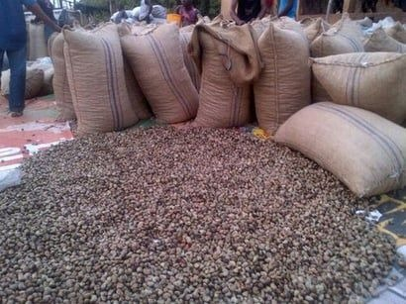
Cashew Nut Shell (CNS):
*
Slide 32
Notes:
33
SRMIST RAMAPURAM CAMPUS

Slide 34
Cashew Nut Shell (CNS) Properties:
Specific Gravity/30° C | 0.950 - 0.970
Viscosity at 30° C cps, Max. | 550.0
Moisture % by weight, Max. | 1.0
Matter Insoluble in Toluene % by weight, Max. | 1.08
Loss in Weight on heating, % by Weight, Max | 2.0
*
Slide 33
Notes:
34
SRMIST RAMAPURAM CAMPUS

Slide 35
Cashew Nut Shell (CNS) Applications:
It is profoundly impervious to grating linings, paints, stains, overlay pitches, composite elastic tars, cashew concrete, polyurethane based polymers, surfactants, epoxy, and water impervious to synthetics. Gums, foundry synthetic compounds and substance intermediates. CNSL gum is broadly utilized as a base covering part because of its incredible protection from water and synthetic substances.
CNSL is utilized as an option in contrast to linseed oil in the production of foundry center oil utilized as a fastener in fashion.
Basic and corrosive arrangements, mineral and greasy oils and different natural solvents forestall warming of adjusted CNSL burner lacquers within the sight of explicit gas pedals.
CNSL is an astounding natural substance for against consumption covering details.
*
Slide 34
Notes:
35
SRMIST RAMAPURAM CAMPUS

Slide 36
Industrial Significance of Cashew Nut Shell (CNS):
Low-cost final.
Versatile ingenuity of polymerization and chemical modification.
Opportunities to develop high-performance polymers.
Property advantages over finals in some applications such as impact resistance, flexibility, rapid heat dissipation etc.
*
Slide 35
Notes:
36
SRMIST RAMAPURAM CAMPUS

Slide 37
Advantaged of Cashew Nut Shell (CNS) based Polymers:
Adaptability and fragility have been gotten to the next level.
Natural Solvent Solubility
Processability has been gotten to the next level.
Rubbing has low blur attributes.
'Cold Wear' obstruction.
Great electrical obstruction.
Further developed Water Repellency.
Salt and corrosive obstruction has been moved along.
Similarity with different sorts of polymers.
Antimicrobial action.
Protection from termites and bugs.
*
Slide 36
Notes:
37
SRMIST RAMAPURAM CAMPUS

Slide 38
Cashew Nut Shell (CNS) Extraction Process:
In the oil bath process about 10% of oil is recovered as a by-product. By using expellers for extraction, it is possible to extract a further quantity of about 10% more from the shells. Thus from 1 tone of shells using oil bath process, up to 100 KG of good quality of CNSL could be extracted by using oil expellers. The percentage oil extracted from the shell of the cashew was found to be 25.5% while that extracted from the kernel was 11.8% oil. The results of the physical analysis showed that the cashew kernel oil (CKO) is light yellow while the Cashew Nut Shell Liquid (CNSL) is dark brown.
*
Slide 37
Notes:
38
SRMIST RAMAPURAM CAMPUS

Slide 39
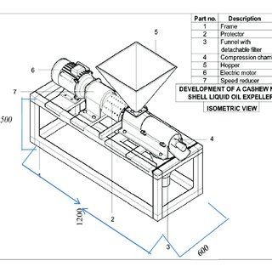
CNSL Etraction Machine Layout :
*
Slide 38
Notes:
39
SRMIST RAMAPURAM CAMPUS

Slide 40
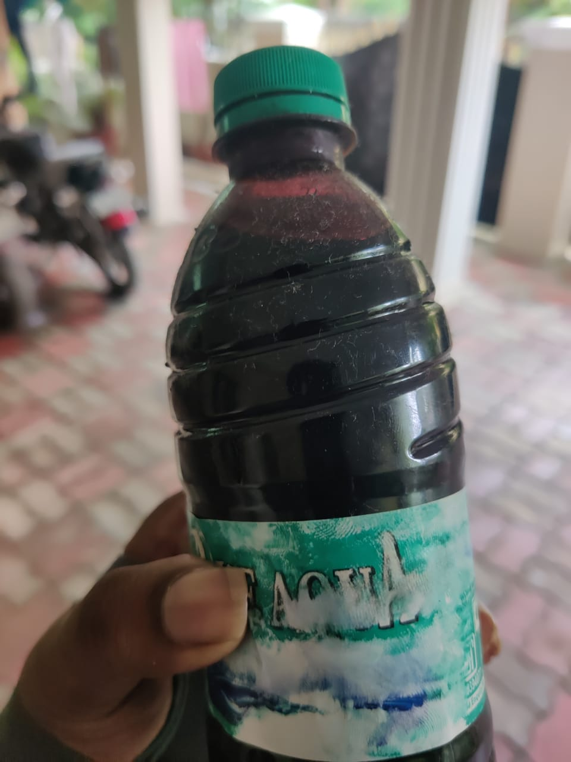
Uncracked CNSL:
*
Slide 39
Notes:
40
SRMIST RAMAPURAM CAMPUS

Slide 41
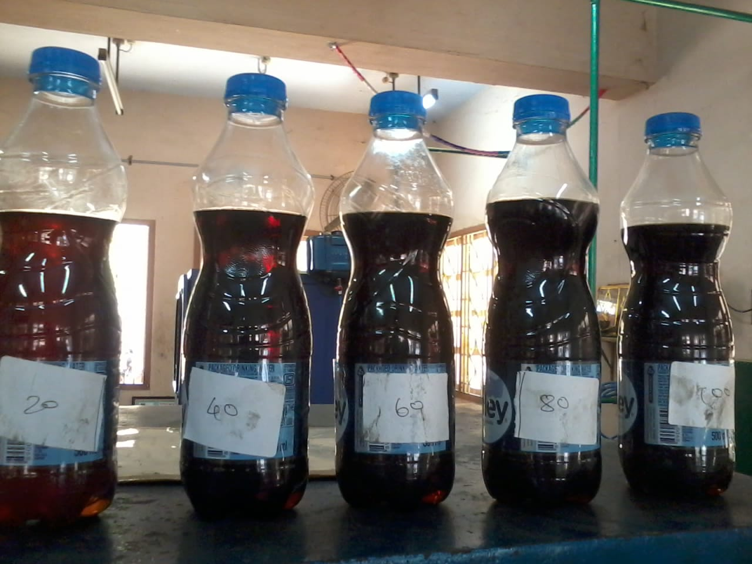
Cracked CNSL:
*
Slide 40
Notes:
41
SRMIST RAMAPURAM CAMPUS

Slide 42
CNSL 100%:
% of Load | Calculated Load |  | Time Taken for 10cc of fuel comsumption |  |  | EGT | Smoke Density | CO | HC | CO₂ | O₂ | Nox | λ
 | N | kgf | t1 | t2 | t_{avg} | °C | HSU | % by volume | ppm | % by volume | % by volume | ppm
20 | 33.534 | 3.4 | 35.60 | 34.98 | 35.29 | 115 | 28.3 | 0.08 | 19 | 2.80 | 15.06 | 205 | 4.687
40 | 67.689 | 6.9 | 32.52 | 32.18 | 32.35 | 163 | 32.5 | 0.08 | 24 | 3.30 | 16.99 | 436 | 4.550
60 | 101.043 | 10.3 | 28.92 | 28.01 | 28.46 | 195 | 42.6 | 0.09 | 38.5 | 4.20 | 13.40 | 683 | 3.205
80 | 135.378 | 13.8 | 22.96 | 22.10 | 22.53 | 263 | 56.5 | 0.18 | 58.5 | 3.78 | 14.33 | 723 | 2.851
100 | 169.713 | 17.3 | 18.96 | 18.11 | 18.53 | 291 | 74.8 | 0.46 | 67.0 | 3.93 | 13.86 | 891 | 1.052
*
Slide 41
Notes:
42
SRMIST RAMAPURAM CAMPUS

Slide 43
Types of Nano Materiel :
Al₂O₃
CeO₂
TiO₂
CuO
ZnO
*
Slide 42
Notes:
43
SRMIST RAMAPURAM CAMPUS

Slide 44
Nano Materiel We Choose:
Aluminium Oxide (Al₂O₃)
*
Slide 43
Notes:
44
SRMIST RAMAPURAM CAMPUS

Slide 45
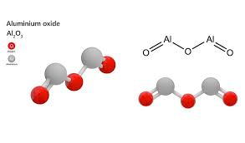
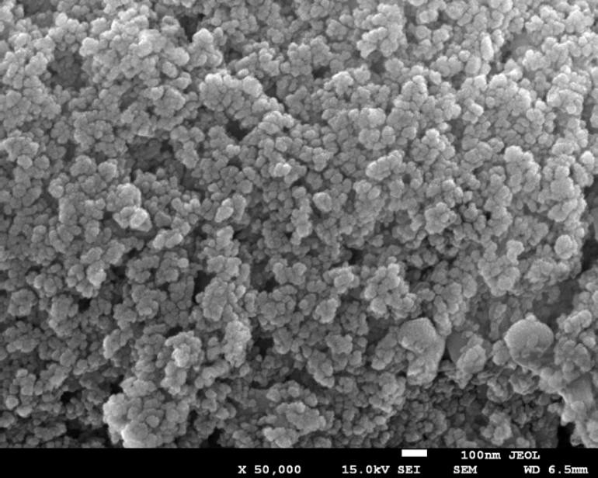
Nano Materiel (Al₂O₃):
*
Slide 44
Notes:
45
SRMIST RAMAPURAM CAMPUS

Slide 46
Nano Materiel (Al₂O₃) Properties:
Al₂O₃ | Aluminium oxide
Molecular Weight/ Molar Mass | 101.96 g/mol
Density | 3.95 g/cm³
Boiling Point | 2,977 °C
Melting Point | 2,072 °C
*
Slide 45
Notes:
46
SRMIST RAMAPURAM CAMPUS

Slide 47
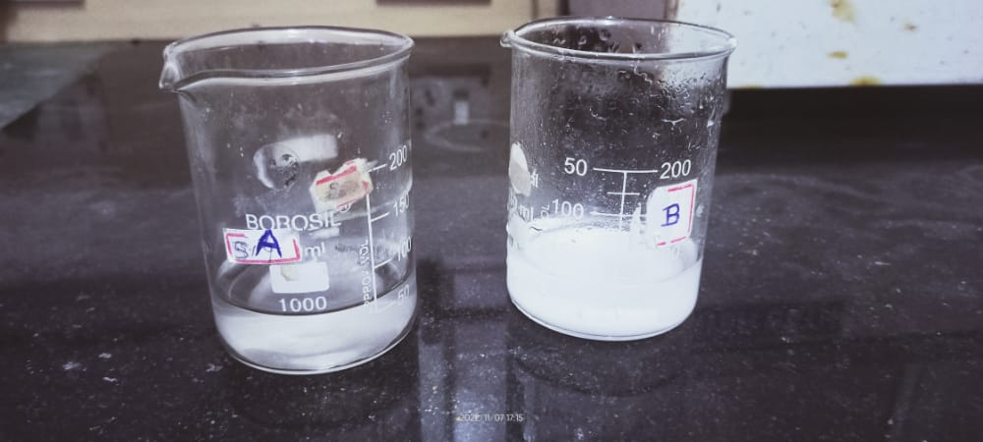


Nano Materiel (Al₂O₃) While Preparing:
*
Slide 46
Notes:
47
SRMIST RAMAPURAM CAMPUS

Slide 48

Nano Materiel (Al₂O₃):
*
Slide 47
Notes:
48
SRMIST RAMAPURAM CAMPUS

Slide 49
CNSL (Bio Diesel) + Al₂O₃ with 100ppm:
% of Load | Calculated Load |  | Time Taken for 10cc of fuel comsumption |  |  | EGT | Smoke Density | CO | HC | CO₂ | O₂ | Nox | λ
 | N | kgf | t1 | t2 | t_{avg} | °C | HSU | % by volume | ppm | % by volume | % by volume | ppm
20 | 33.534 | 3.4 | 42.58 | 42.10 | 42.34 | 123 | 28.2 | 0.08 | 19 | 3.24 | 20.95 | 215 | 5.321
40 | 67.689 | 6.9 | 35.58 | 35.23 | 35.40 | 168 | 36.6 | 0.09 | 23 | 3.85 | 19.63 | 435 | 4.321
60 | 101.043 | 10.3 | 33.58 | 33.18 | 33.38 | 198 | 40.5 | 0.08 | 36.1 | 4.2 | 18.65 | 695 | 3.285
80 | 135.378 | 13.8 | 28.02 | 27.76 | 27.89 | 278 | 54.3 | 0.17 | 52 | 3.28 | 17.68 | 742 | 2.112
100 | 169.713 | 17.3 | 20.42 | 20.02 | 20.22 | 305 | 70.3 | 0.42 | 61.5 | 3.11 | 12.15 | 916 | 1.056
*
Slide 48
Notes:
49
SRMIST RAMAPURAM CAMPUS

Slide 50
CNSL (Bio Diesel) + Al₂O₃ with 150ppm:
% of Load | Calculated Load |  | Time Taken for 10cc of fuel comsumption |  |  | EGT | Smoke Density | CO | HC | CO₂ | O₂ | Nox | λ
 | N | kgf | t1 | t2 | t_{avg} | °C | HSU | % by volume | ppm | % by volume | % by volume | ppm
20 | 33.534 | 3.4 | 43.82 |  |  | 148 | 24.5 | 0.06 | 14 | 4.85 | 19.38 | 236 | 6.285
40 | 67.689 | 6.9 | 38.18 |  |  | 193 | 30.6 | 0.06 | 16 | 3.85 | 18.36 | 456 | 5.366
60 | 101.043 | 10.3 | 32.70 |  |  | 218 | 36.3 | 0.07 | 32 | 3.26 | 19.35 | 730 | 4.112
80 | 135.378 | 13.8 | 25.25 |  |  | 325 | 46.8 | 0.14 | 46 | 3.95 | 16.88 | 762 | 3.116
100 | 169.713 | 17.3 | 19.45 |  |  | 342 | 54.9 | 0.35 | 58.5 | 2.85 | 4.60 | 894 | 2.183
*
Slide 49
Notes:
50
SRMIST RAMAPURAM CAMPUS

Slide 51
Nano Materiel We Choose (For Comparison Reference):
Cerium Oxide (CeO₂)
[ For comparison reference we tested CeO₂ ]
*
Slide 50
Notes:
51
SRMIST RAMAPURAM CAMPUS

Slide 52
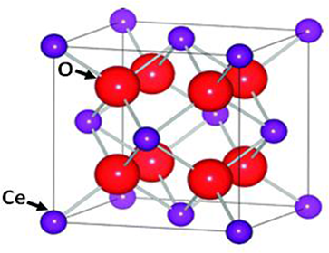
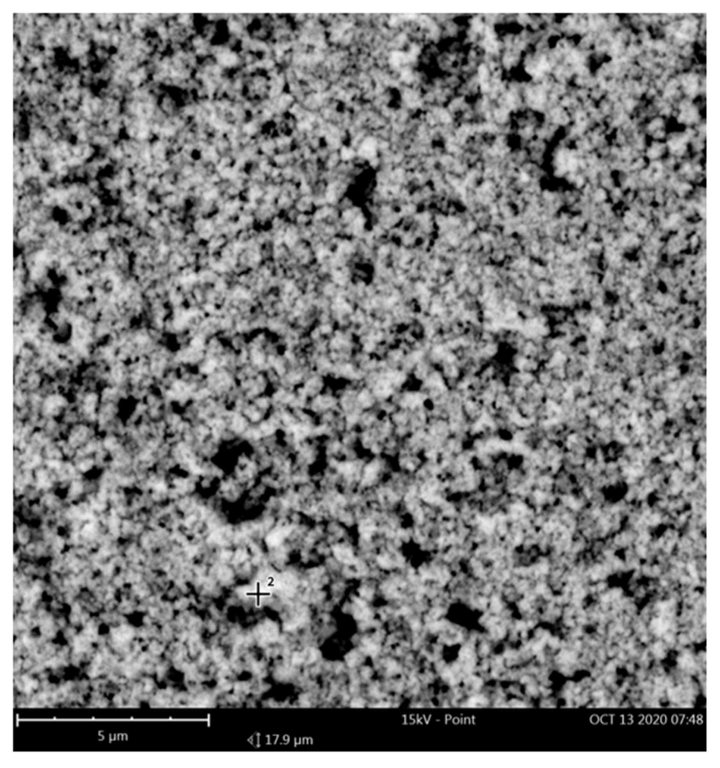
Nano Materiel (CeO₂):
*
Slide 51
Notes:
52
SRMIST RAMAPURAM CAMPUS

Slide 53
Nano Materiel (CeO₂) Properties:
CeO₂ | Cerium oxide
Molecular Weight/ Molar Mass | 172.155 g/mol
Density | 7.215 g/cm³
Boiling Point | 3500 °C
Melting Point | 2400 °C
*
Slide 52
Notes:
53
SRMIST RAMAPURAM CAMPUS

Slide 54

Nano Materiel (CeO₂):
*
Slide 53
Notes:
54
SRMIST RAMAPURAM CAMPUS

Slide 55
CNSL (Bio Diesel) + CeO₂ with 100ppm:
% of Load | Calculated Load |  | Time Taken for 10cc of fuel comsumption |  |  | EGT | Smoke Density | CO | HC | CO₂ | O₂ | Nox | λ
 | N | kgf | t1 | t2 | t_{avg} | °C | HSU | % by volume | ppm | % by volume | % by volume | ppm
20 | 33.534 | 3.4 | 45.71 | 44.96 | 45.33 | 122 | 27.5 | 0.08 | 18 | 4.85 | 19.35 | 210 | 5.321
40 | 67.689 | 6.9 | 36.10 | 35.87 | 35.98 | 163 | 31.5 | 0.08 | 24 | 4.93 | 19.63 | 420 | 4.310
60 | 101.043 | 10.3 | 30.20 | 30.10 | 30.15 | 210 | 41.6 | 0.09 | 35.2 | 3.22 | 18.12 | 680 | 3.108
80 | 135.378 | 13.8 | 27.53 | 27.21 | 27.37 | 265 | 52.4 | 0.16 | 48.5 | 2.93 | 17.65 | 755 | 2.183
100 | 169.713 | 17.3 | 18.77 | 18.01 | 18.39 | 310 | 68.5 | 0.40 | 60.2 | 3.12 | 19.35 | 935 | 1.058
*
Slide 54
Notes:
55
SRMIST RAMAPURAM CAMPUS

Slide 56
CNSL (Bio Diesel) + CeO₂ with 150ppm:
% of Load | Calculated Load |  | Time Taken for 10cc of fuel comsumption |  |  | EGT | Smoke Density | CO | HC | CO₂ | O₂ | Nox | λ
 | N | kgf | t1 | t2 | t_{avg} | °C | HSU | % by volume | Ppm | % by volume | % by volume | ppm
20 | 33.534 | 3.4 | 44.13 | 43.96 | 44.04 | 130 | 25.2 | 0.07 | 15 | 3.48 | 19.65 | 220 | 6.285
40 | 67.689 | 6.9 | 35.29 | 35.01 | 35.15 | 182 | 31.3 | 0.07 | 14 | 3.65 | 18.42 | 430 | 5.338
60 | 101.043 | 10.3 | 28.38 | 28.10 | 28.24 | 195 | 34.8 | 0.09 | 36 | 3.26 | 17.63 | 706 | 4.128
80 | 135.378 | 13.8 | 23.89 | 22.01 | 22.95 | 285 | 48.5 | 0.16 | 48 | 3.93 | 18.42 | 753 | 3.218
100 | 169.713 | 17.3 | 16.89 | 16.22 | 16.55 | 318 | 56.5 | 0.38 | 59.3 | 2.85 | 17.35 | 873 | 2.112
*
Slide 55
Notes:
56
SRMIST RAMAPURAM CAMPUS

Slide 57
Engine Used:
KIRLOSKAR TV-1 ENGINE
*
Slide 56
Notes:
57
SRMIST RAMAPURAM CAMPUS

Slide 58
Engine Specifications:
Specifications | Specifications
Type | Vertical, Water cooled, Four Stroke
Bore | 87.5 mm
Stroke | 110 mm
Number of Cylinders | 1
Compression Ratio | 17.5:1
Power | 5.2 kW
Speed | 1500 rpm
Loading Device | Eddy Current Dynamometer
Injection Timing | 23° before TDC
Injection Pressure | 220 bar
*
Slide 57
Notes:
58
SRMIST RAMAPURAM CAMPUS

Slide 59
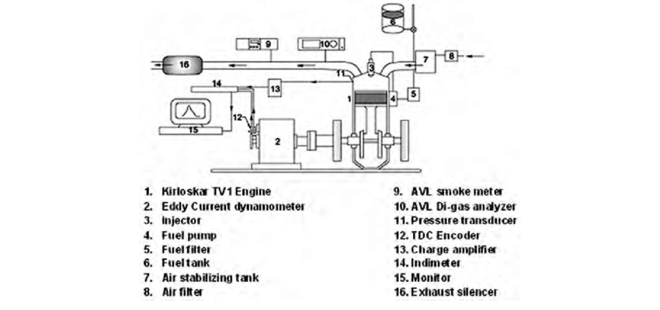
Engine Layout:
*
Slide 58
Notes:
59
SRMIST RAMAPURAM CAMPUS

Slide 60

Engine Image:
*
Slide 59
Notes:
60
SRMIST RAMAPURAM CAMPUS

Slide 61
EXPECTED OUTCOME:
Expecting that CI Engine will run give good performance and efficiency with the combination of CNSL+Al₂O₃
*
Slide 60
Notes:
61
SRMIST RAMAPURAM CAMPUS

Slide 62
OUTCOME:
*
Slide 61
Notes:
62
SRMIST RAMAPURAM CAMPUS

Slide 63
Thank You
*
Slide 62
Notes:
63
SRMIST RAMAPURAM CAMPUS

